Slide 1


The Effect
of Sunlight
on the Earth's Surface
Explore how the Sun warms the Earth

Slide 2
Today's Topics
1
2
3
4
What is the Sun?
How Does the Sun Warm the Earth?
Sun's Effect on Earth's Materials
Shade and How It's Produced

Slide 3









Spot the Difference!
Can you spot six differences between these two images?

Slide 4
ANSWER KEY
Spot the Difference!
Can you spot six differences between these two images?
4
1
5
2
6
3
Daytime
Nighttime
The Sun is visible in the sky, giving off heat and light.
The Sun has gone down and the sky becomes dark.

Slide 5
At the end of the lesson,
you'll learn to...
1
2
3
investigate the effects of sunlight on Earth.
observe how the Sun warms the Earth's materials.
explain how shade is produced.
FUN FACT!
The Sun is the closest star to Earth.

Slide 6
What is the Sun?
It's a big ball of hot gas in space.
The Sun is a star made up mostly of hydrogen and helium.
It gives us light and heat.
The Sun is very far away, but its light and heat reach us daily.

Slide 7
How Does the Sun Warm the Earth?
The Sun's rays carry heat to the Earth's surface.
The light coming from the Sun carries energy.
It becomes heat when it hits a surface.

Slide 8





Thinking Hats On!
Why are some areas in the playground warmer while others cooler?
On a sunny day, which is warmer to touch: the pavement or the soil?

Slide 9

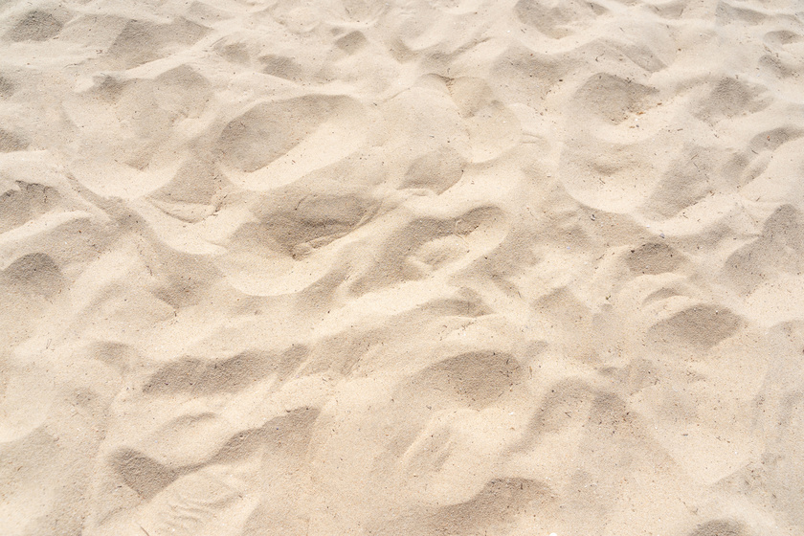
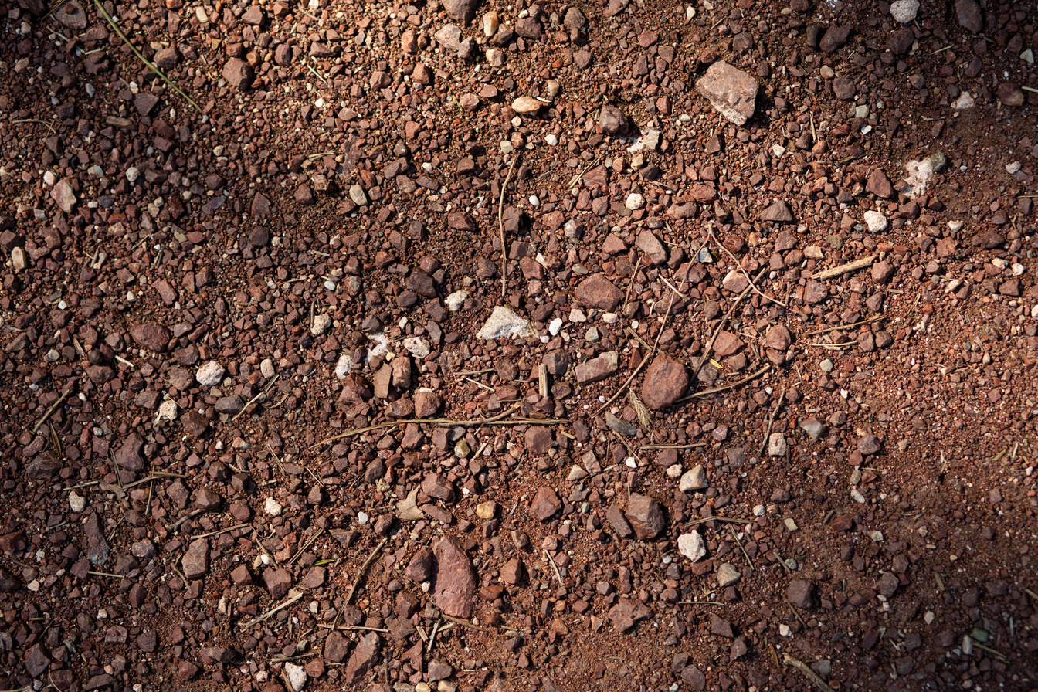


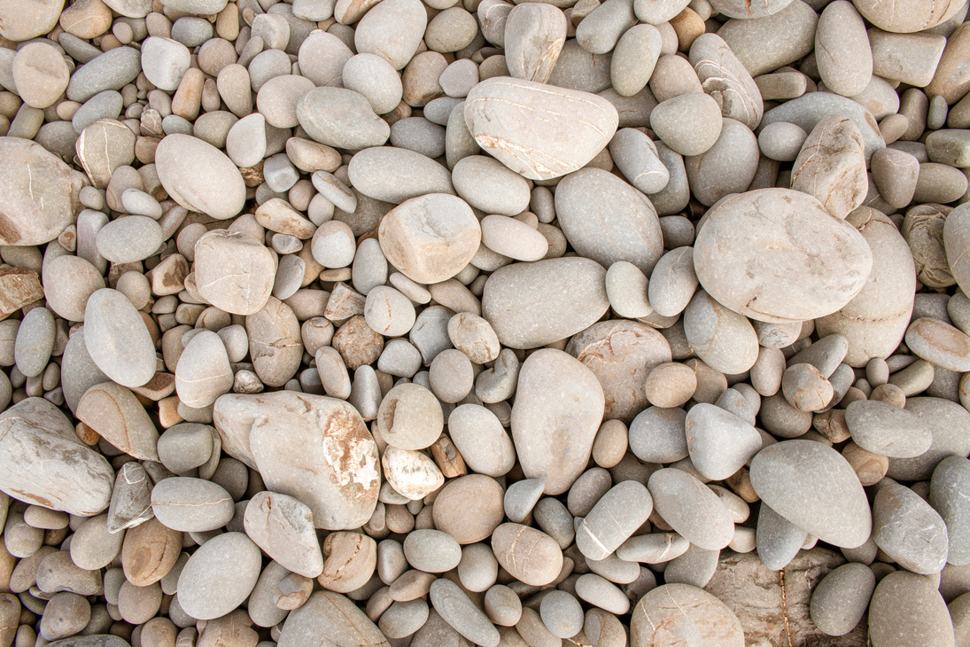
Sun's Effect on Earth's Materials
The Sun affects different materials in different ways.
These materials on Earth’s surface will warm up from sunlight in different amounts and at different rates.
Sand
Soil
Water
Rocks

Slide 10



Sun's Effect on Earth's Materials
Different colored materials under the sun will warm at different rates.
Heat is absorbed.
Heat bounces off.
Darker-colored materials absorb more light and get warm faster than light-colored materials.

Slide 11




Shade and How It's Produced
Shade forms when a structure blocks the Sun's rays. It protects us and provides relief from the Sun's heat.

Slide 12



There are different ways to produce shades and block the sunlight.
Planting trees
Using tents and umbrellas
Constructing
buildings or shelters

Slide 13


Try to Remember!
The Sun provides us with light and heat.
Sun's heat has different effects on Earth's materials.
Shade provides relief and protection from the Sun's heat.
When the Sun's rays reach Earth, the light energy changes to heat.
The darker the material, the more heat it absorbs, hence the faster it gets warm.
Shade provides relief and protection from the Sun's heat.
REFERENCE
Mitchell D. Chester, Ed.D., Commissioner. "Sunlight Warms Earth’s Surface." Model Curriculum. Revised July 2018. Accessed from http://millriverschools.org/documents/drivesync/Curriculum%20Website/Science/GL%20K/mcu-SCIgK-SunlightWarms.pdf

