Slide 1






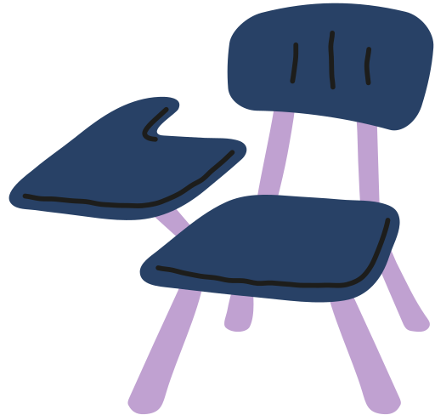


Comparing Decimals
up to Hundredths
Comparing Using Place Value Charts and Area Models
INSPIRED BY

Slide 2

Comparing Decimals in Real-Life
When do comparing decimals come into play in your daily adventures?

Slide 3
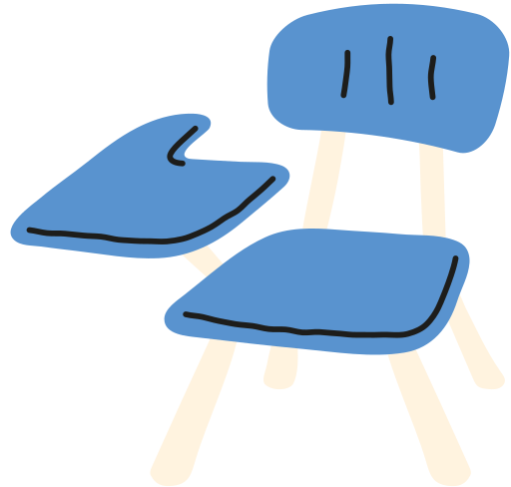
Our Learning Target
In today's lesson, our target is to learn how to compare decimals using place value charts and area models.

Slide 4



Symbols of the Day
Before we dive in, let's recall what these symbols mean.
Greater than
Less than
Equal
Used when the first number has a larger value than the second number.
Used when the first number has a smaller value than the second number.
Used when the first number has the same value as the second number.
5 > 3
3 < 5
5 = 5

Slide 5
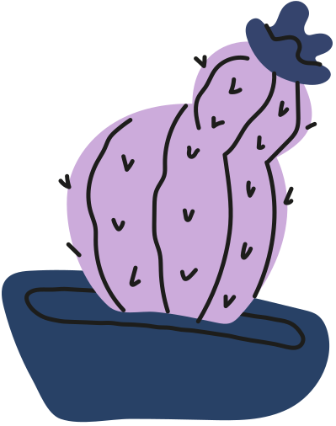
Comparing Using Place Value Charts
Step 1
Place the digits in their corresponding place value.
Another term to describe the ones place is units.
units | . | tenths | hundredths
5 | . | 8 | 7
units | . | tenths | hundredths
5 | . | 3 | 9

Slide 6

Comparing Using Place Value Charts
Step 2
Compare the digits from the largest place value.
A.
If the digits are the same, move to the next place value to the right.
units | . | tenths | hundredths
5 | . | 8 | 7
units | . | tenths | hundredths
5 | . | 3 | 9

Slide 7
Comparing Using Place Value Charts
Step 2
Compare the digits from the largest place value.
B.
If the digits are different, determine which digit is greater.
units | . | tenths | hundredths
5 | . | 8 | 7
units | . | tenths | hundredths
5 | . | 3 | 9

Slide 8
Comparing Using Place Value Charts
Step 3
Use the symbols, >, <, or = to describe the relationship of two numbers.
units | . | tenths | hundredths
5 | . | 8 | 7
5 | . | 3 | 9
In the tenths place, 8 is greater than 3. This means that 5.87 is greater than 5.39. In symbols, 5.87 > 5.39.

Slide 9
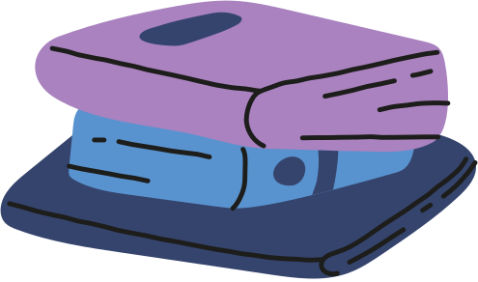
Comparing Using Area Models
Step 1
Draw a model for each decimal. Remember that 0.01 is 1 out of 100 parts and 1 is equivalent to 100 parts.
1.45
1.67

Slide 10
Comparing Using Area Models
Step 2
Compare the shaded regions of each model. The number with more shaded regions has greater value.
1.45
1.67
The number with more shaded regions has greater value.

Slide 11
Comparing Using Area Models
Step 3
Use the symbols, >, <, or = to describe the relationship of two numbers.
1.45
1.67
In symbols, 1.45 < 1.67.

Slide 12
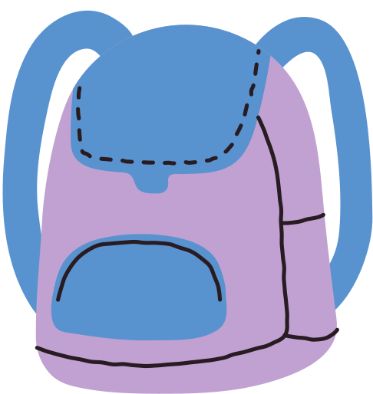

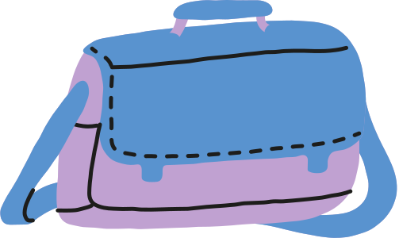

Which bag comes with a lower price tag?
Place <, >, = on the blank to make the statement true.
$3.26
$3.23

Slide 13



Answer Key
Which bag comes with a lower price tag?
Place <, >, = on the blank to make the statement true.
units | . | tenths | hundredths
3 | . | 2 | 6
3 | . | 2 | 3
$3.26
$3.23
The satchel comes with a lower price tag.

Slide 14
Recap
We can compare two decimal numbers using the following methods.
place value chart
area models
units | . | tenths | hundredths
3 | . | 2 | 6
3 | . | 2 | 3

Slide 15


A Question to Ponder!
Apart from using place value charts and area models, what are other ways we can compare decimals?

Slide 16
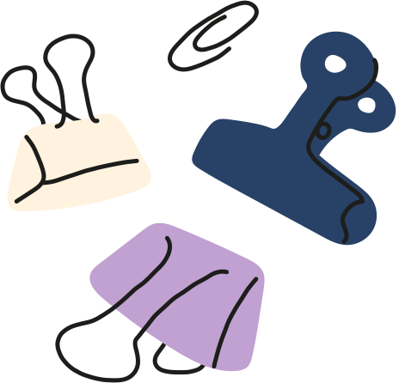
References
Mathspace. “6.04 Compare decimals
| Grade 4 Math | Common Core 4 - 2022 Edition.” Accessed 3 July 2023, https://mathspace.co/textbooks/syllabuses/Syllabus-1090/topics/Topic-21201/subtopics/Subtopic-274634/

Slide 17

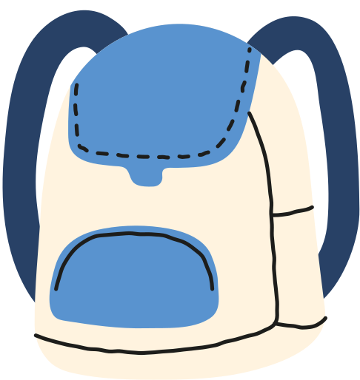
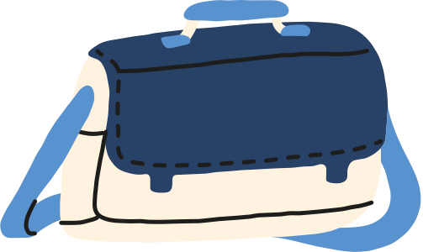
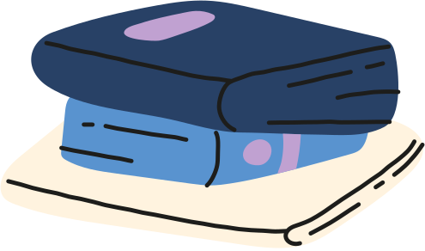


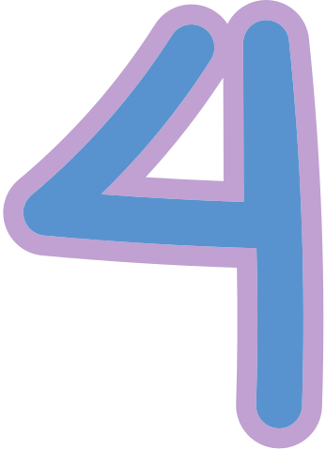
Resource
Page
Use these icons and illustrations in your Canva Presentation. Happy designing! Don't forget to delete this page before presenting.

Slide 18


Try this background for online class.
  *Please delete this section before downloading.

Slide 19


B
for blur
c
for confetti
Press these keys
while on Present mode!
D
for drumroll
m
for mic drop
0
for bubbles
Q
for quiet
Any number from 0-9 for a timer
u
for unveil
0-9

