Slide 1
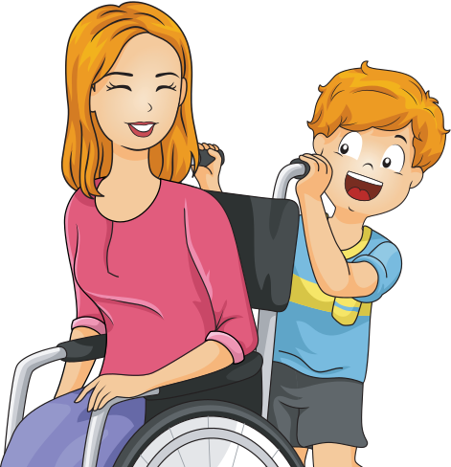
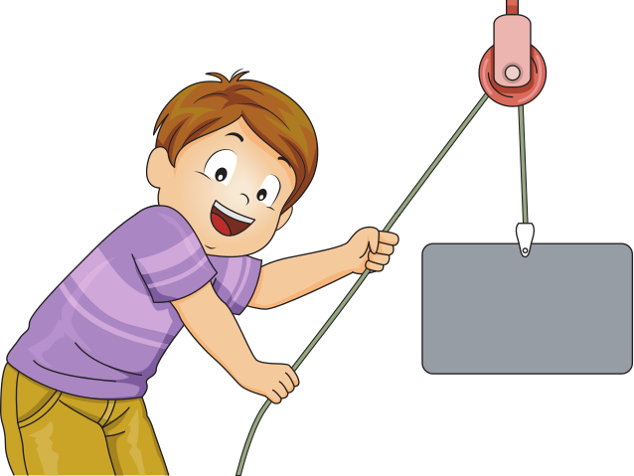
FORCE & MOTION
KINDERGARTEN SCIENCE PRESENTATION

Slide 2
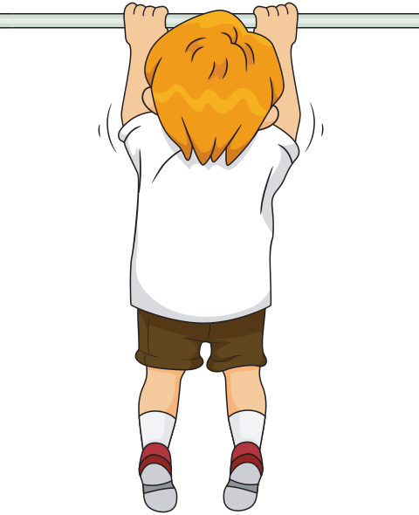
FORCES
Force can be a push or a pull that can make an object move or stop moving. It is something that can change the speed or direction of an object.

Slide 3
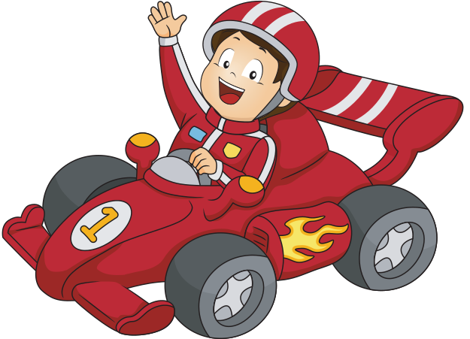
FORCES
Examples of forces include pushing a toy car across the floor, pulling a wagon, or kicking a ball.
Forces can be strong or weak, and they can be applied in different directions.

Slide 4
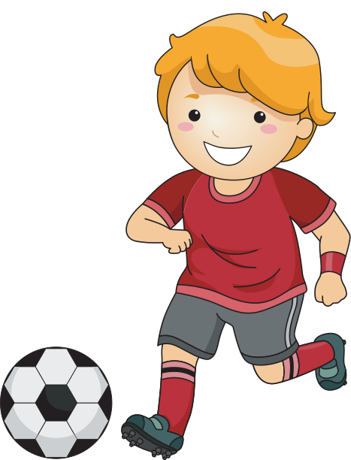
FORCES
Look at the following pictures.
What kind of force is being used to make these objects move?
Circle both if they apply!

Slide 5
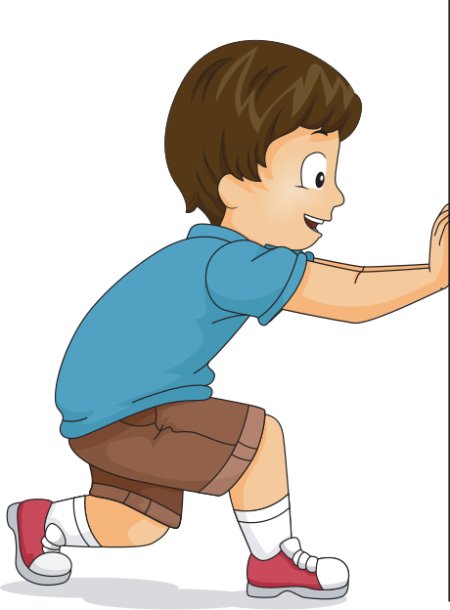
push
pull

Slide 6
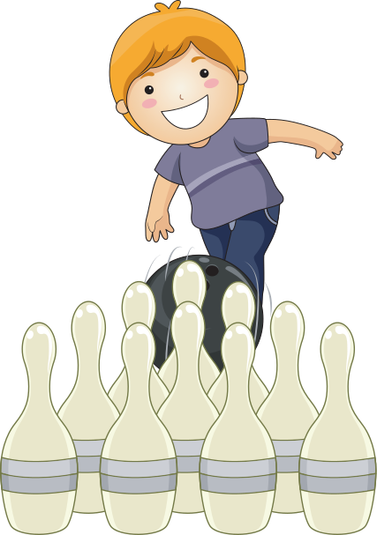
push
pull

Slide 7
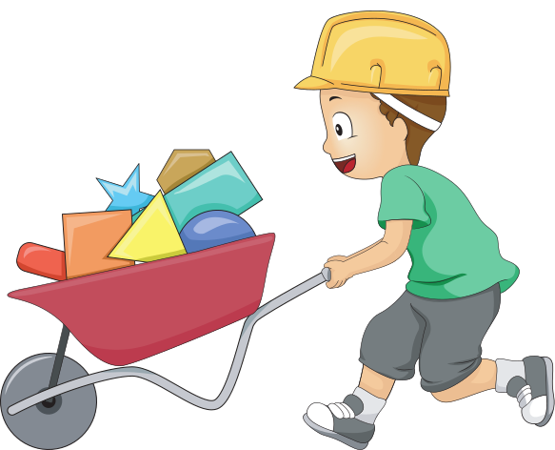
pull
push

Slide 8

pull
push

Slide 9
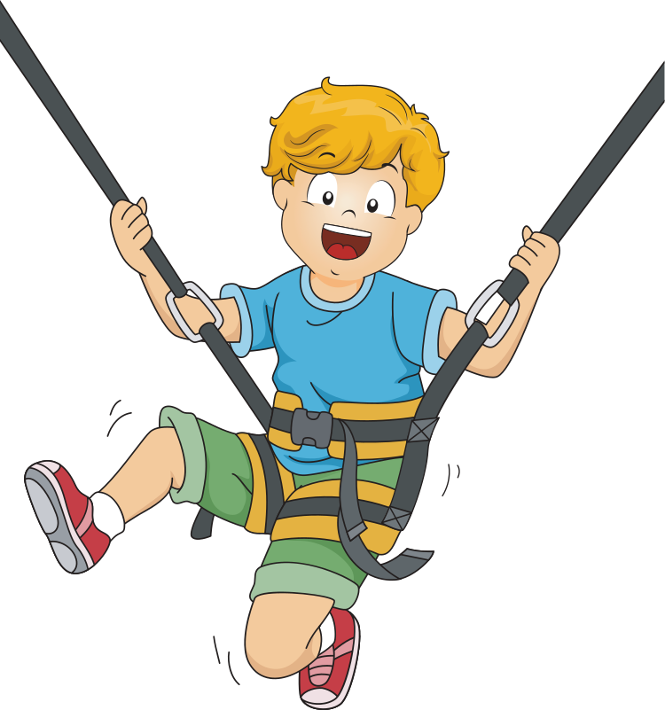
push
pull

Slide 10
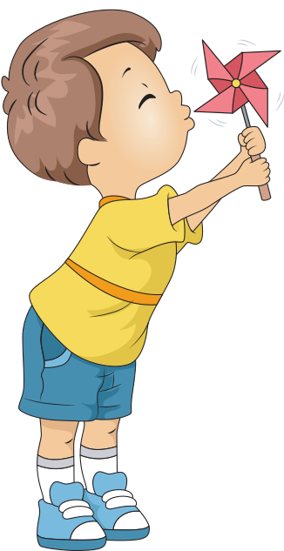
push
pull

Slide 11
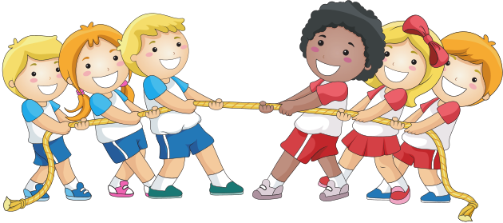
pull
push

Slide 12
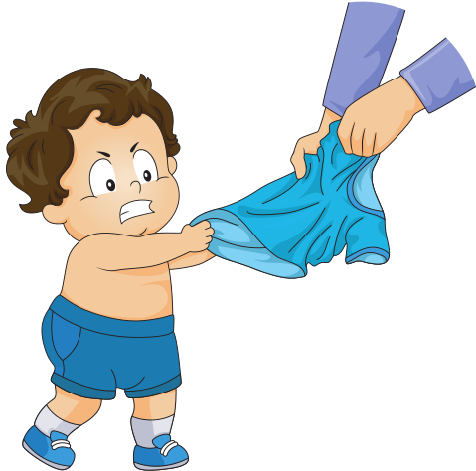
push
pull

Slide 13
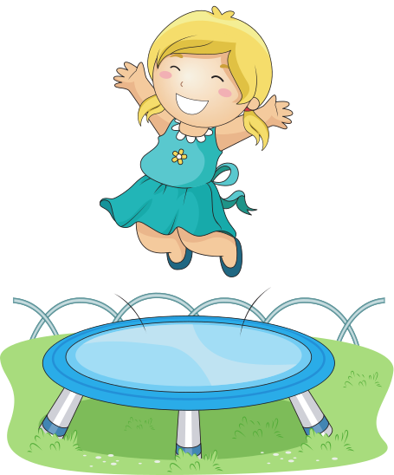
push
pull

Slide 14
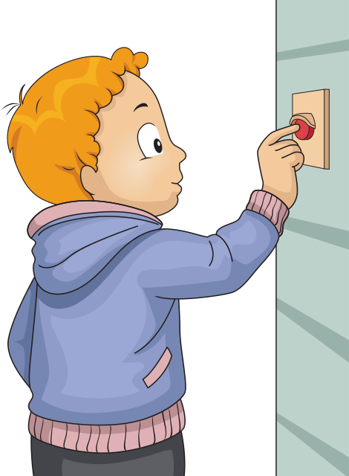
push
pull

Slide 15
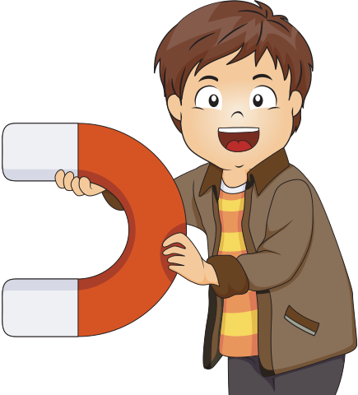
push
pull

Slide 16
push
pull

Slide 17
push
pull

Slide 18
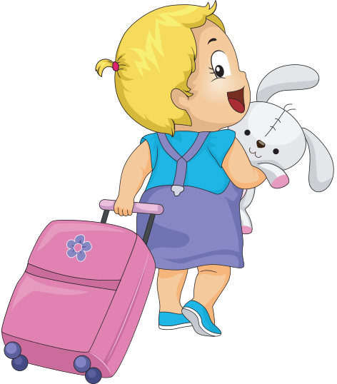
push
pull

Slide 19
push
pull

Slide 20
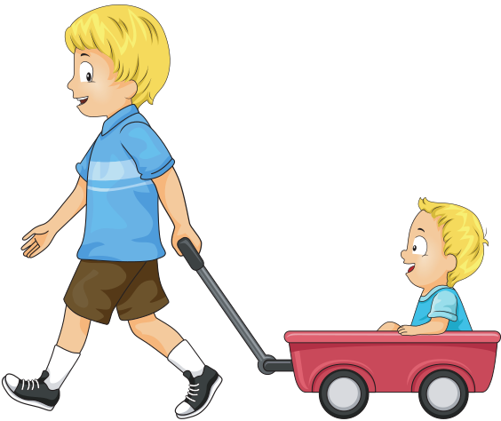
pull
push

Slide 21
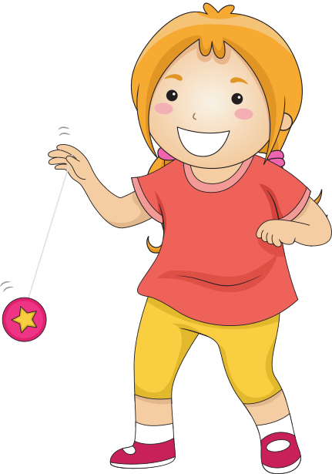
push
pull

Slide 22
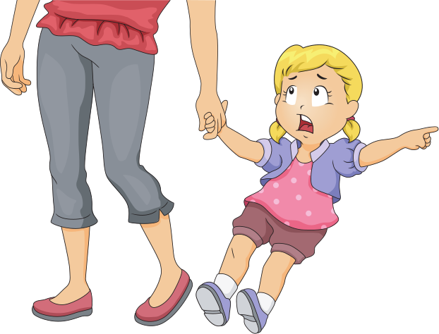
pull
push

Slide 23
APPLYING FORCE
We can apply push and pull forces many ways including
spinning, rolling, kicking, dragging, sliding, squeezing, flicking and swinging.
Circle how force is applied in the following slides:

Slide 24
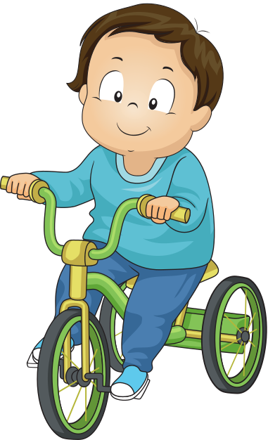
roll
slide

Slide 25
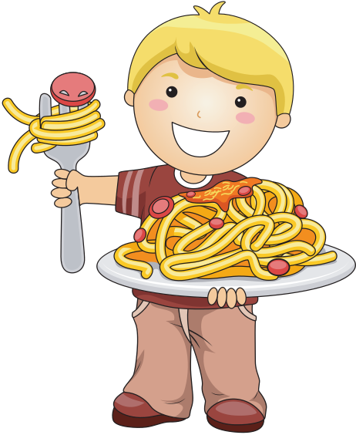
spin
flick

Slide 26
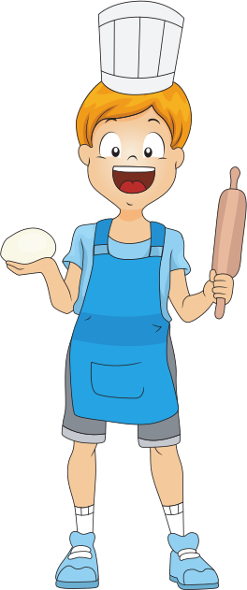
spin
roll

Slide 27
roll
squeeze

Slide 28
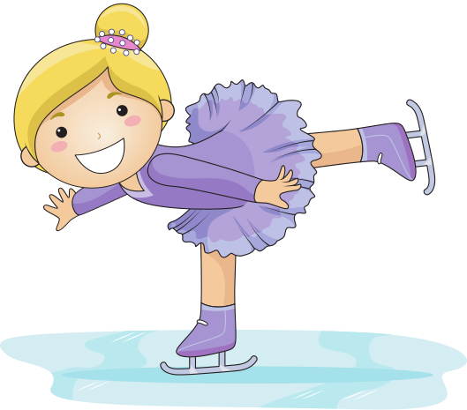
spin
roll

Slide 29
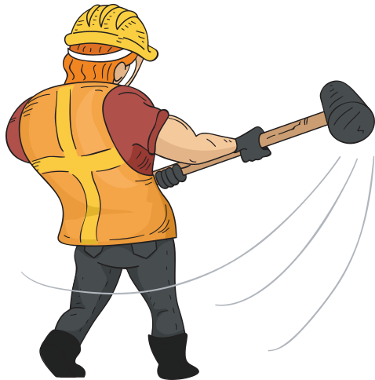
swing
roll

Slide 30
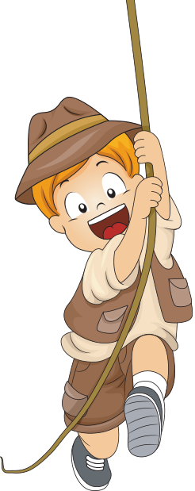
swing
slide

Slide 31

squeeze
swing

Slide 32
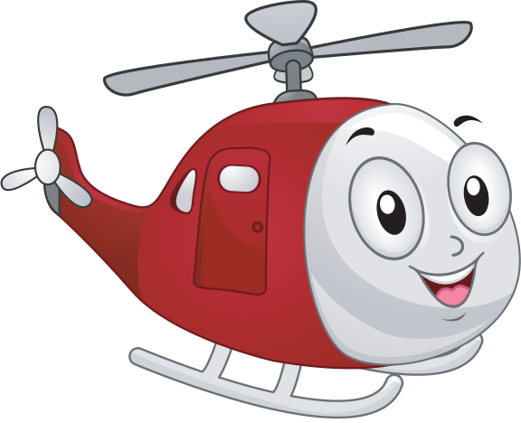
slide
spin

Slide 33
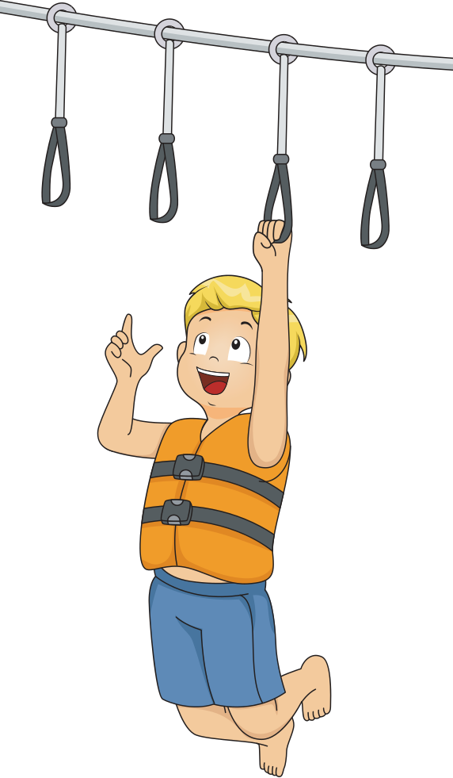
drag
swing

Slide 34
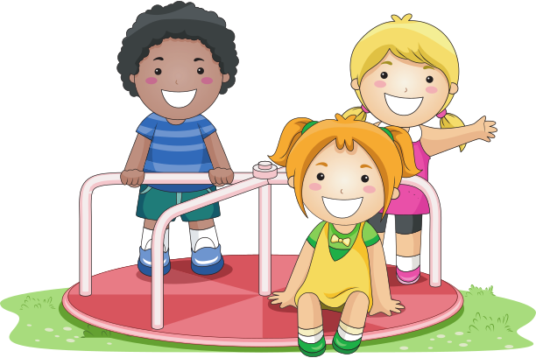
roll
spin

Slide 35
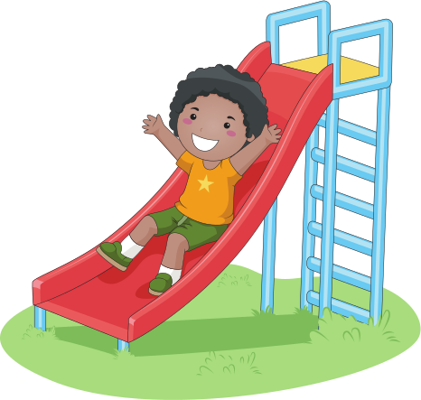
kick
slide

Slide 36
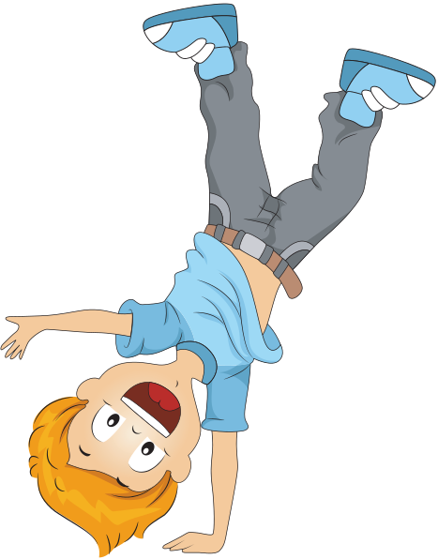
spin
drag

Slide 37
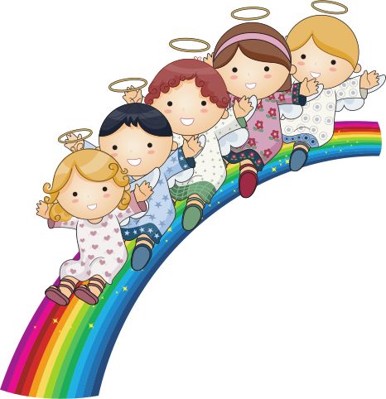
roll
slide

Slide 38
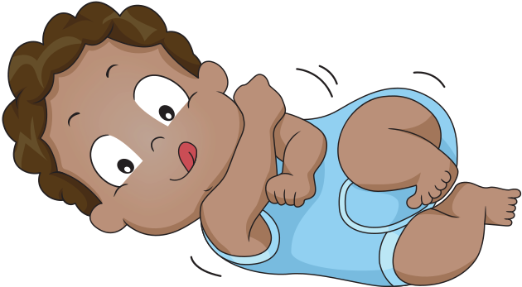
roll
squeeze

Slide 39
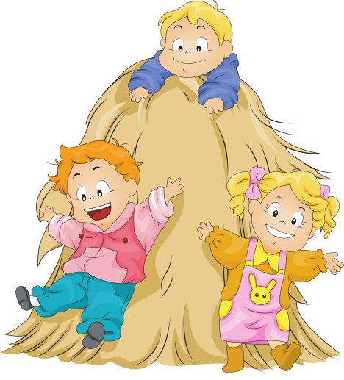
slide
kick

Slide 40
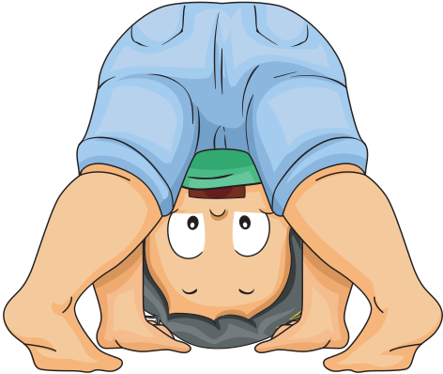
roll
drag

Slide 41
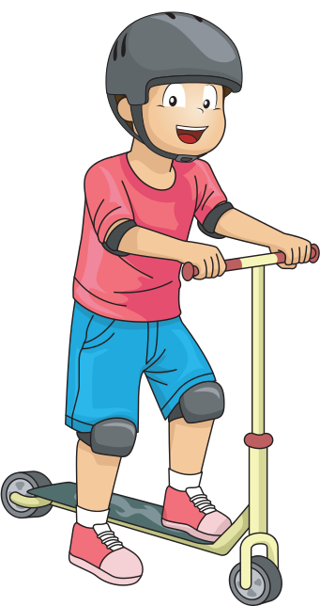
spin
slide

Slide 42
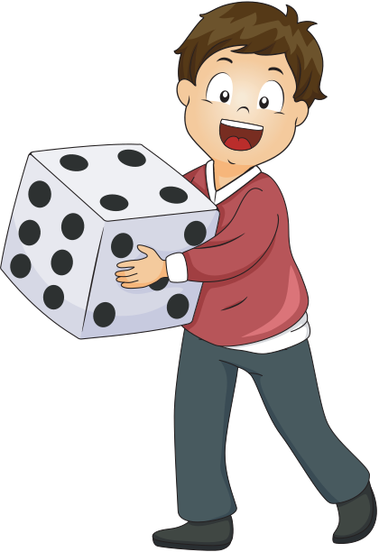
roll
flick

Slide 43
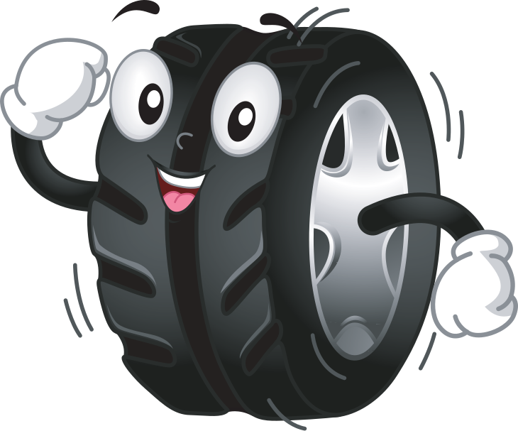
drag
roll

Slide 44
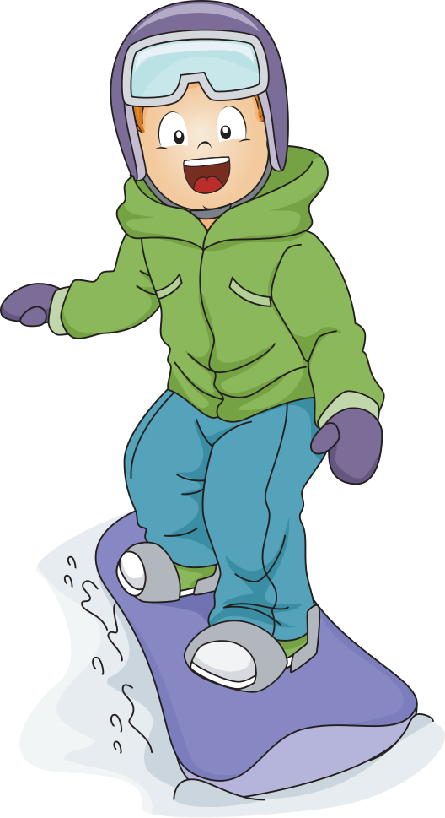
spin
roll

Slide 45
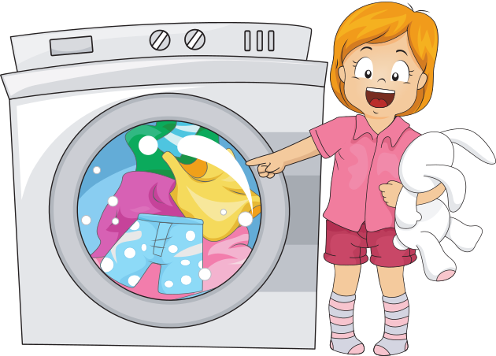
flick
spin

